Slide 1
Data Analysis on Epidemic Diseases
Team:
Vishnu Vardhan Reddy Manne
Vandith Thotla
Sai Haneesh Tanneru
Sai Jaswanth Gattidi

Slide 2
Table of Contents
Motivation/Background
Introduction
Implementation Environment
System Architecture
Visualization Outputs
Problems Tackled/Data Analyzed
Webpage
Cloud deployment
Github and Trello board links

Slide 3
Motivation/Background
There is an undeniable concern internationally with respect to the reality about the rising Novel coronavirus (2019‐nCoV) as an overall general wellbeing risk.
The ongoing flare-up of pneumonia in Wuhan, China, caused by the SARS‐CoV‐2 accentuates the significance of analyzing the epidemiological data of this novel virus and foreseeing their dangers of tainting individuals all around the world.
As this outbreak advances, the epidemiological information are expected to manage the situation’s awareness and mediation methodologies.
In this project, we present a push to compile, analyze and visualize epidemiological outbreak information.

Slide 4
Introduction
An epidemic is the rapid spread of disease to a large number of people in a given population within a short period of time.
In this project we are analyzing the data on epidemic diseases such as Covid-19,Ebola,SARS and H1N1 dependent on the several open datasets on 2019‐nCoV provided by the World Health Organization, Chinese Center for Disease Control and Prevention, Johns Hopkins University, National Health Commission, Kaggle and DXY.
An exploratory data analysis with visualizations has been made to comprehend the number of various cases reported (confirmed, death, and recovered) throughout the world. Overall, at the outset of an outbreak like this, it is crucial to provide information to start the evaluation necessary to comprehend the risks and start containment activities.

Slide 5
Implementation Environment
Google Colab
Pycharm
Flask
Python Language
HTML, CSS
Java Script
Amazon Web Services(AWS)

Slide 6
System Architecture
Datasets
Python Code
(Analysis & Visualization
Flask
(To create a Web Page)
Amazon web services
(Deployment of Web page)

Slide 7

COVID_19 Analysis

Slide 8
COVID_19 Analysis
The 2019 novel corona virus is a new human corona virus which is spreading with epidemic features in China and other Asian countries; cases have also been reported worldwide.
Covid_19 is associated with respiratory illness that may lead to severe pneumonia and acute respiratory distress syndrome(ARDS).
The Covid_19 dataset is obtained from Kaggle and the source dataset keeps on updating for every 12 hours.
The fields in the covid_19 dataset are:[‘Observation Date’, ‘Province’, ‘Country’, ‘Last Update’, ‘Confirmed’, ‘Deaths’, ‘Recovered’].
After obtaining the dataset we have cleaned the dataset to remove the null values and sorted the data based on Date, Country and Province.

Slide 9
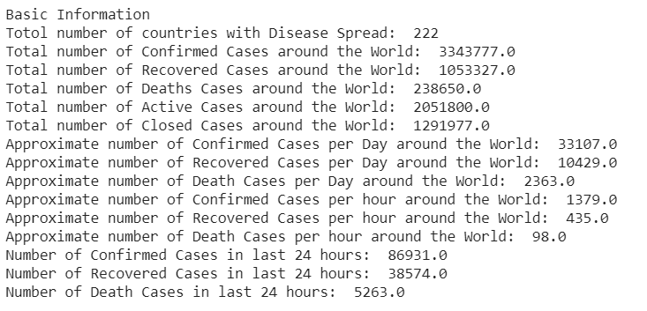
Getting the basic Information till Date

Slide 10
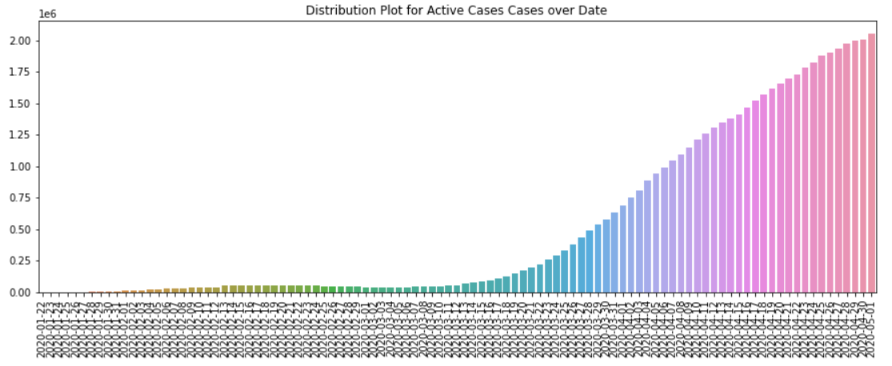
Active Cases Over Date

Slide 11
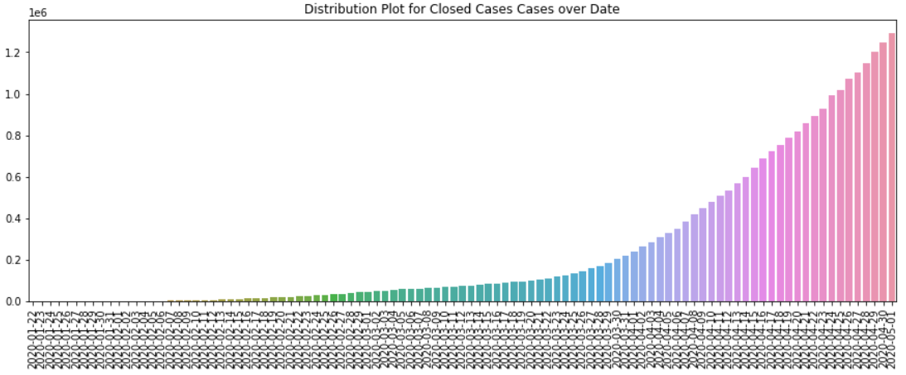
Closed Cases Over Date

Slide 12
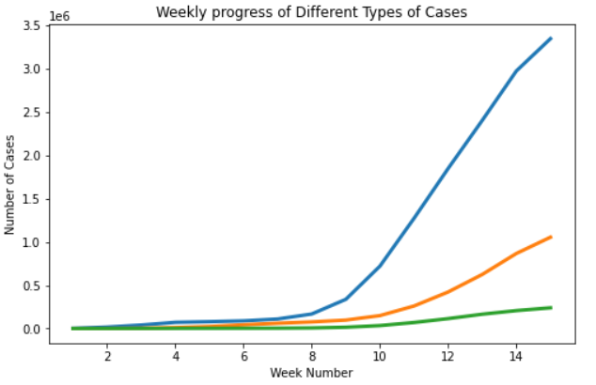
Weekly analysis of Confirmed, Death and Recovered Cases
Here, Confirmed Cases - Blue curve, Recovered Cases – Orange Curve, Death Cases – Green.

Slide 13
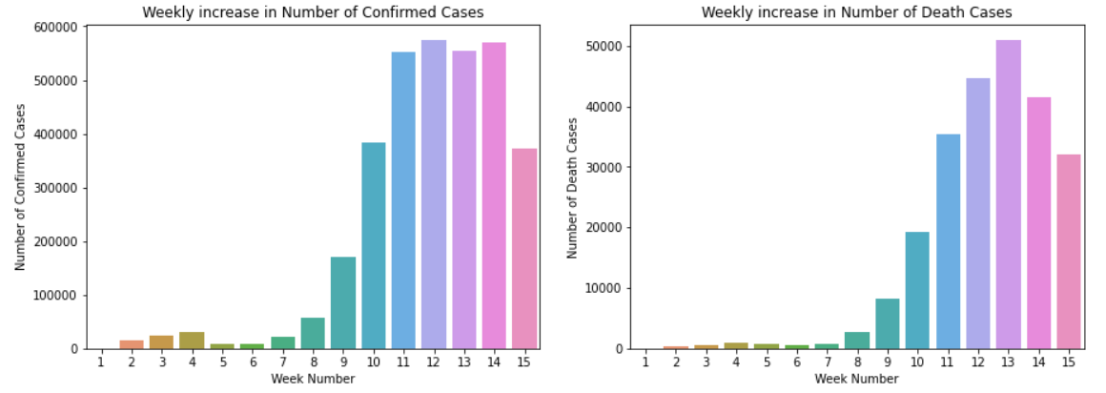
Weekly increase in Number of Confirmed and Death Cases

Slide 14
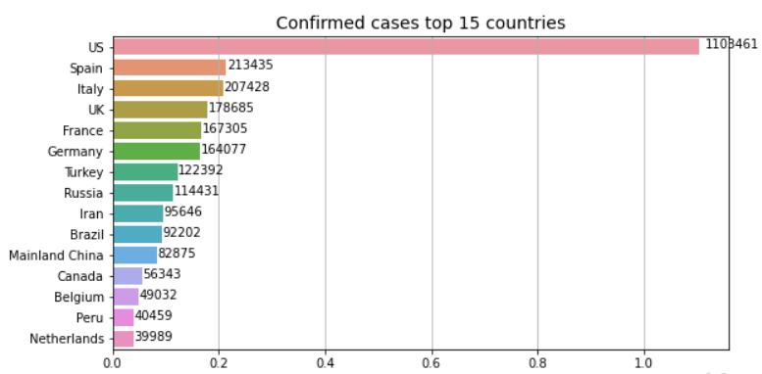
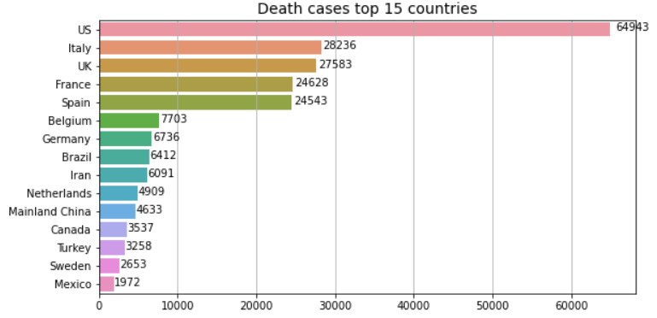
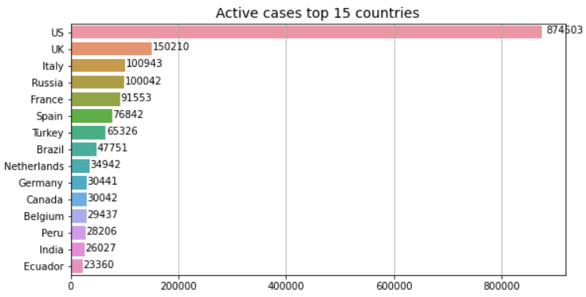
Countries with highest Confirmed, Death and Recovered Cases

Slide 15
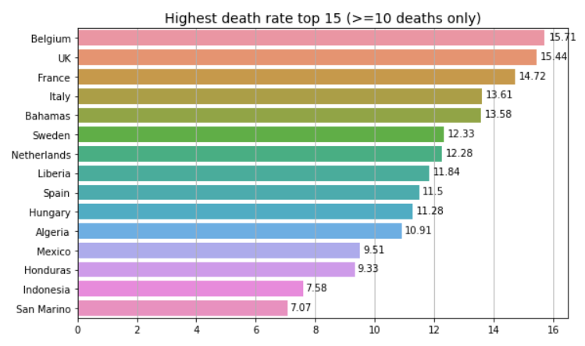
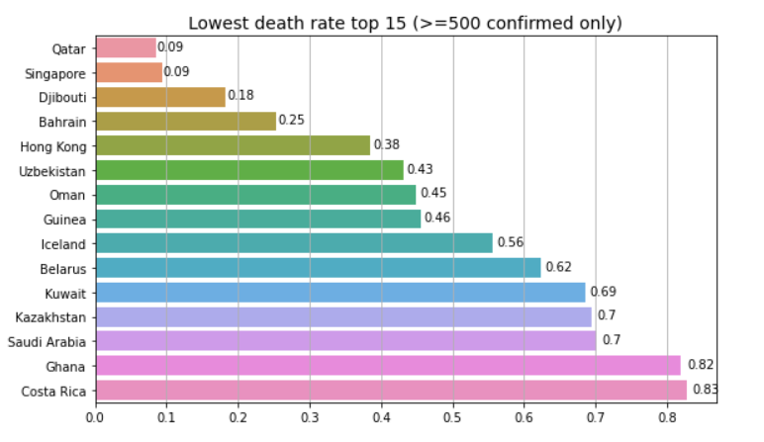
Countries with Highest and Lowest Death Rates

Slide 16
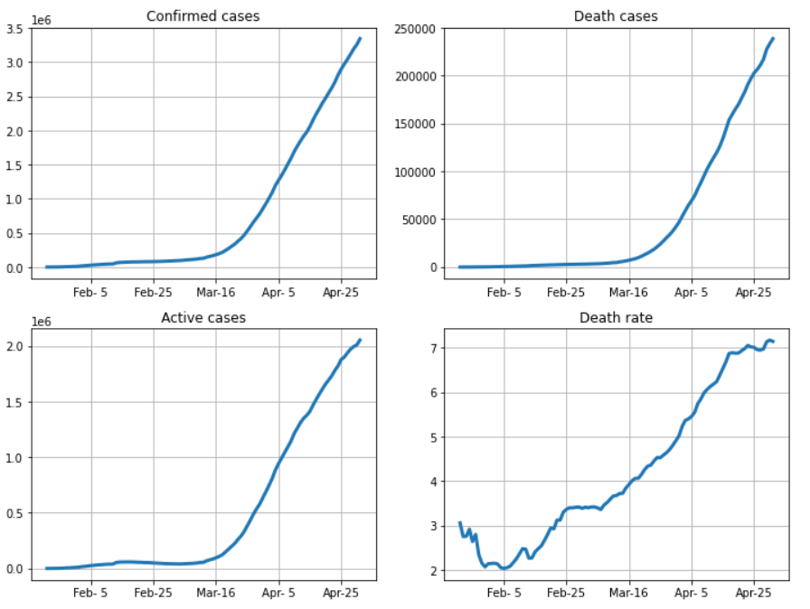
Evolution of Cases in the world over time

Slide 17
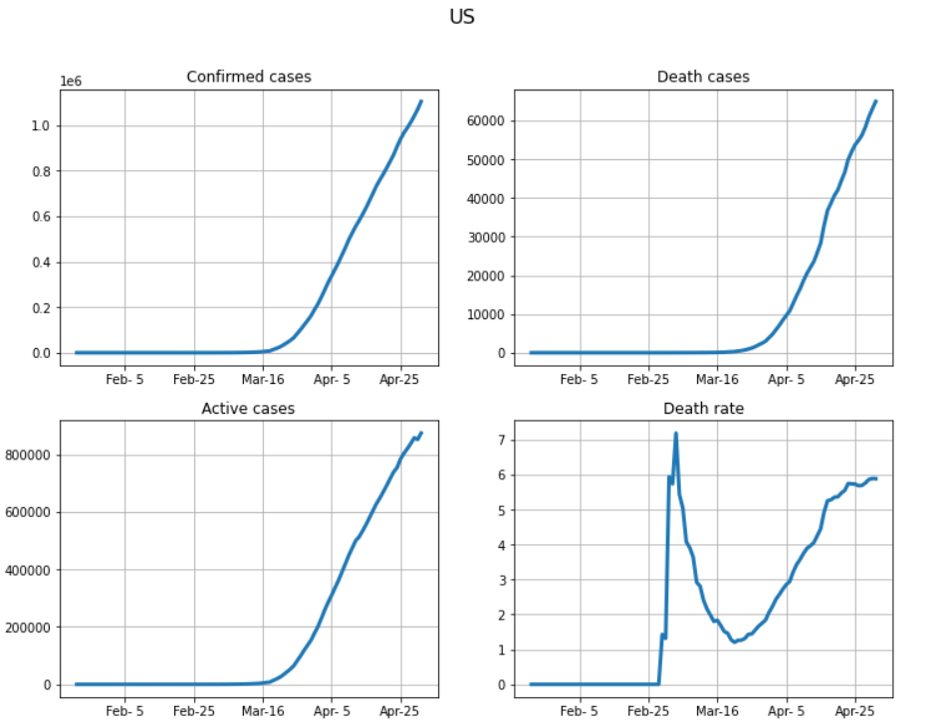
Evolution of Cases in USA
The number of Cases are still increasing Rapidly.

Slide 18
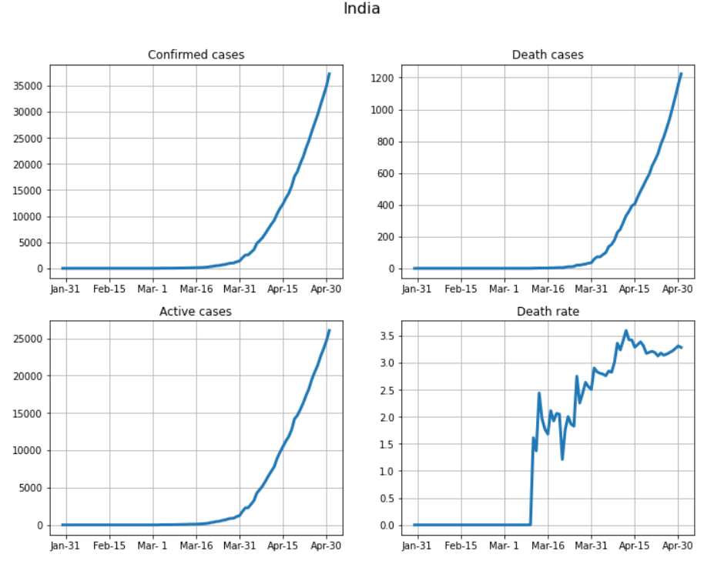
Evolution of Cases in India
There is a steady increase in Confirmed , Active and Death cases.

Slide 19
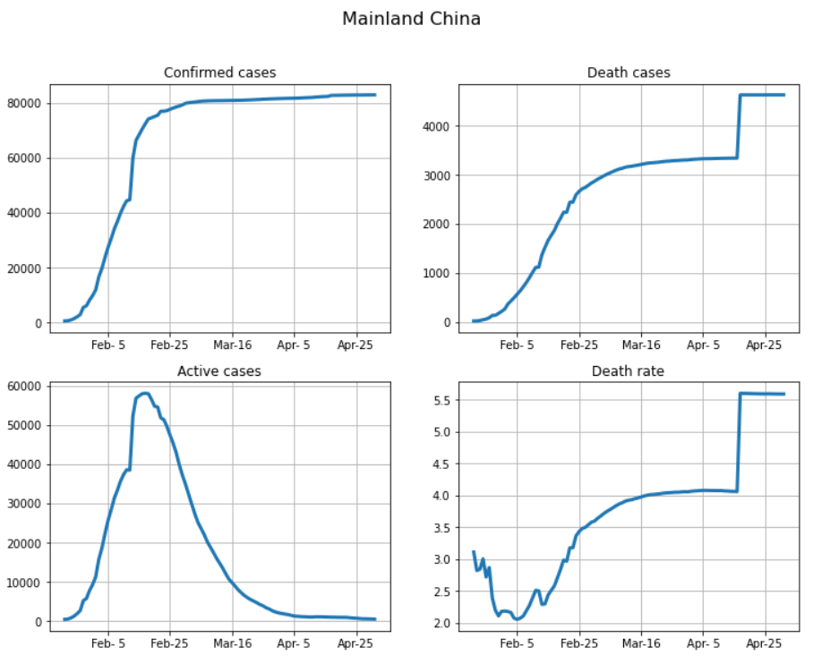
Evolution of Cases in China
Confirmed , Death Cases and Death Rate stay flat since early March.

Slide 20
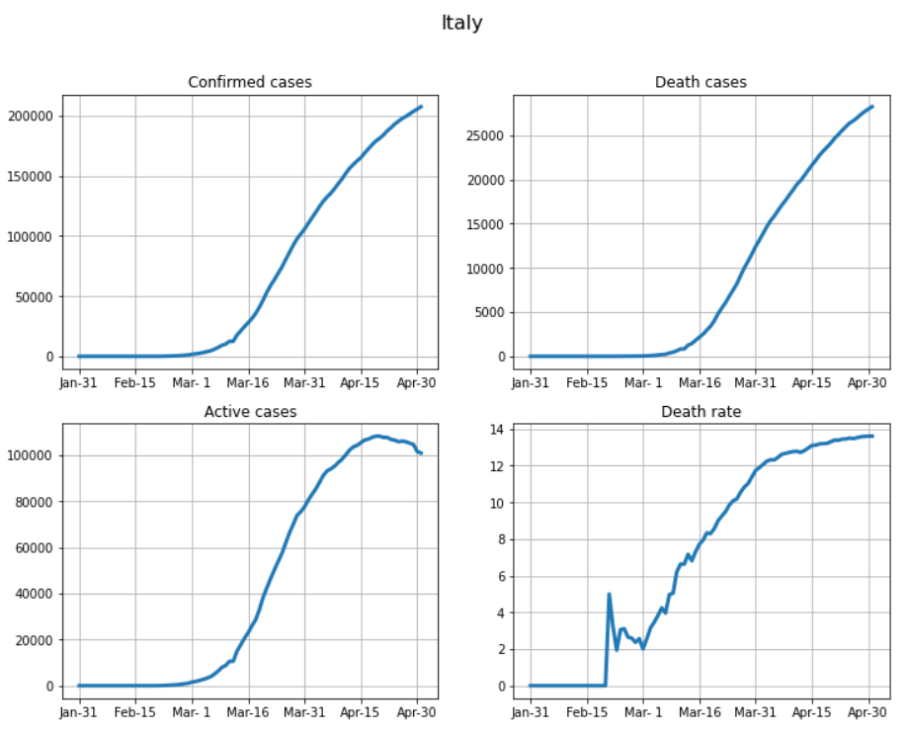
Evolution of Cases in Italy
The number of active cases are decreasing.

Slide 21
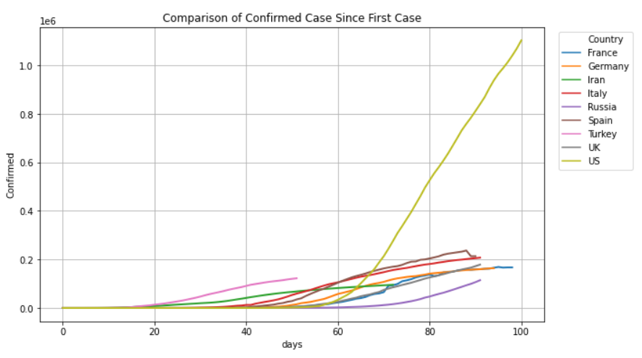
Comparison of Confirmed cases since first case

Slide 22
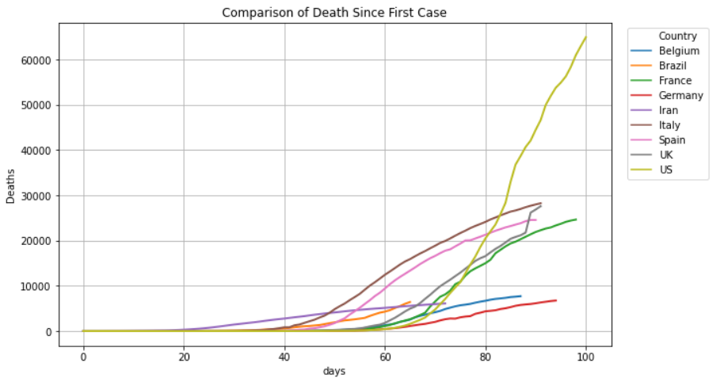
Comparison of Death cases since first case

Slide 23
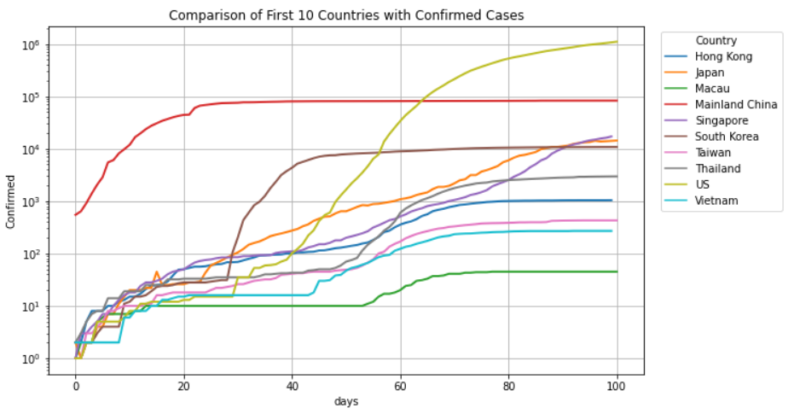
Trajectory of first 10 countries with confirmed cases

Slide 24
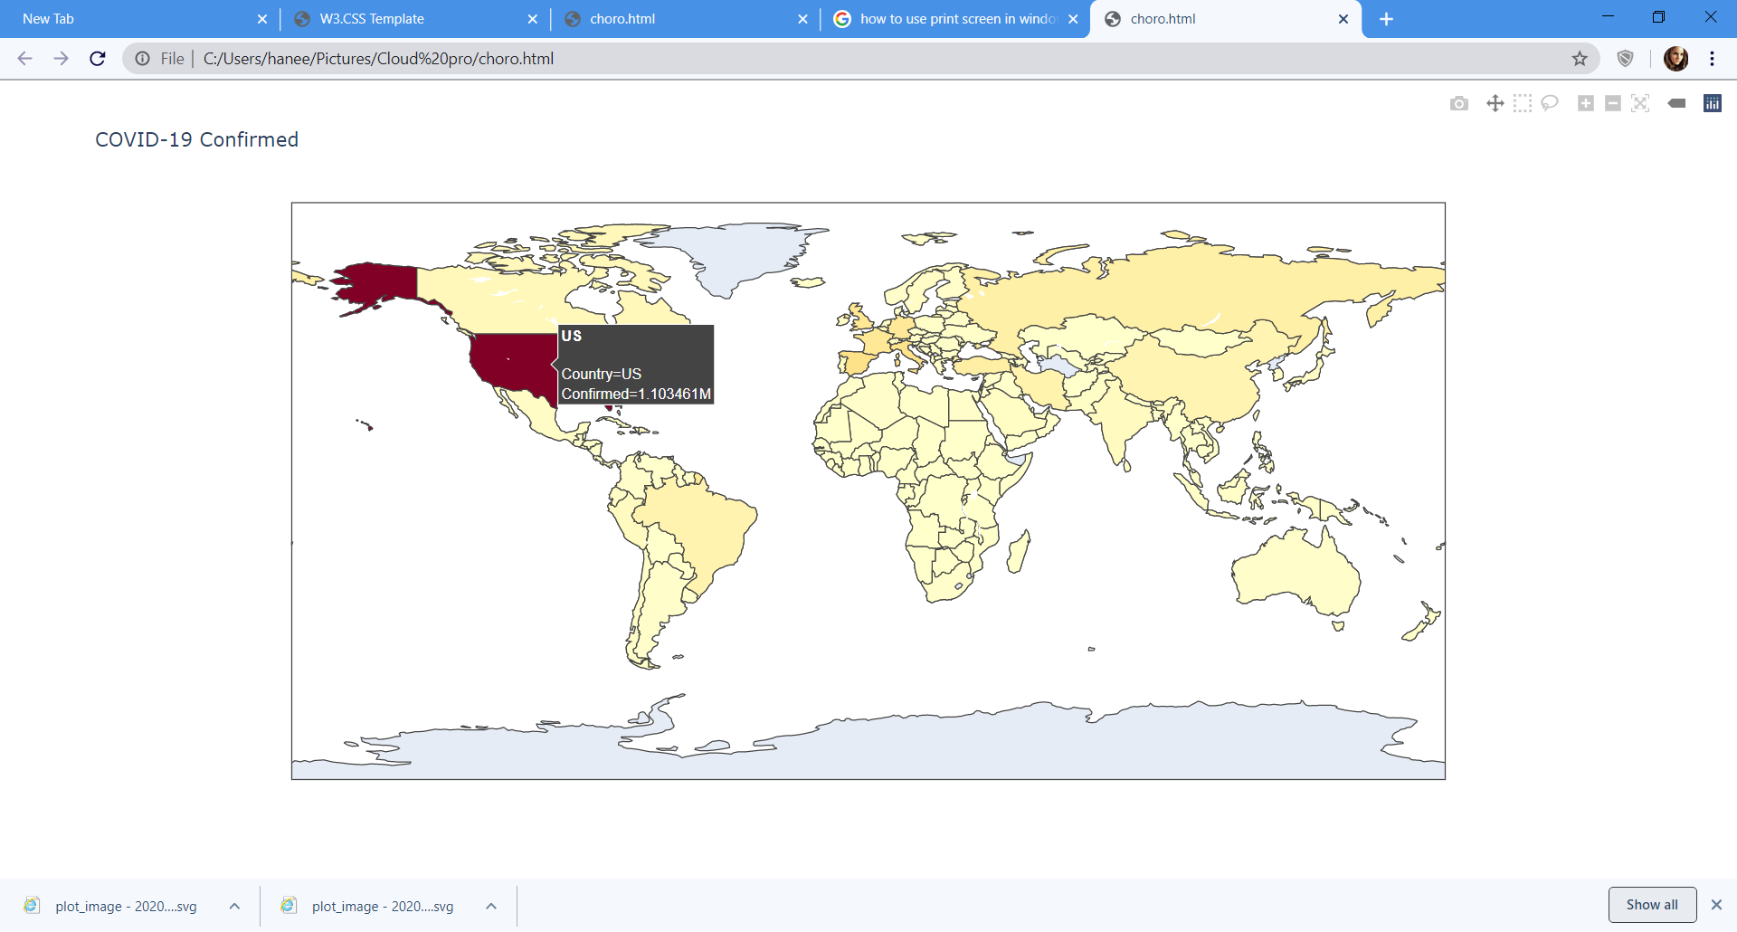
Choropleth representation for Confirmed cases Worldwide

Slide 25
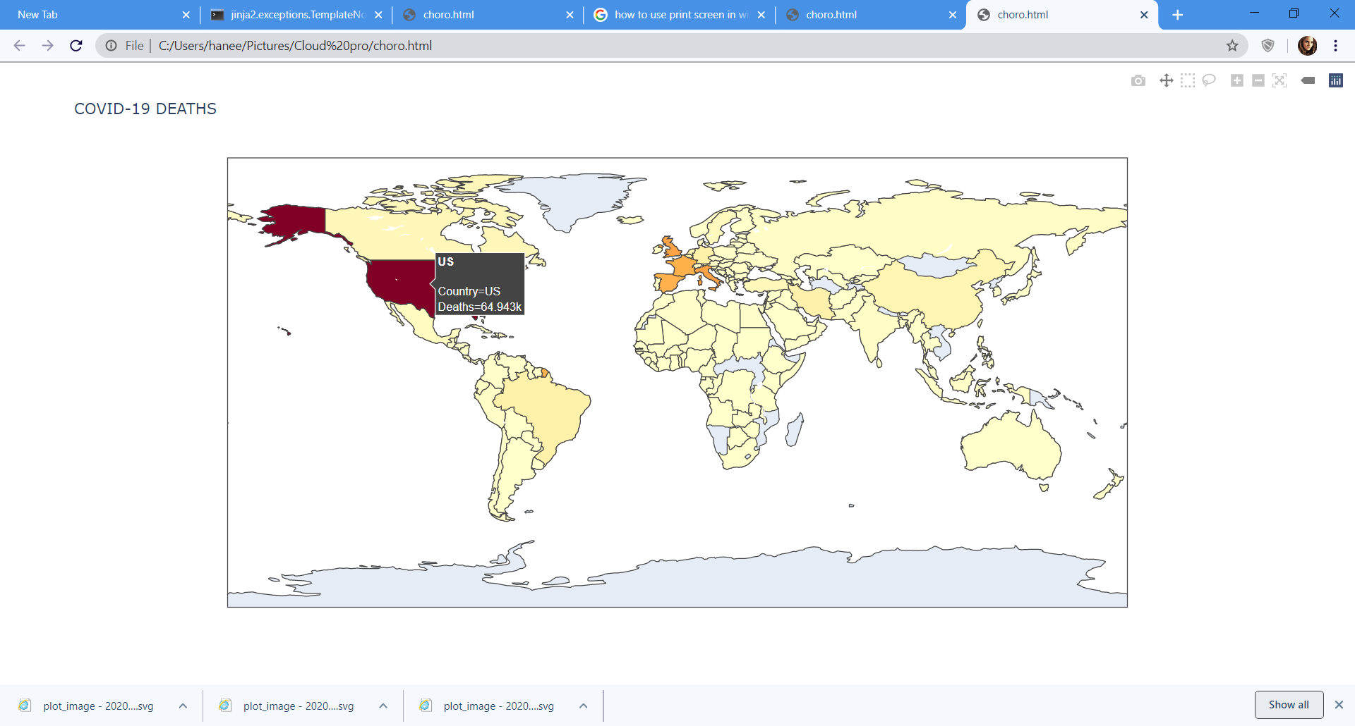
Choropleth representation for Death cases Worldwide

Slide 26
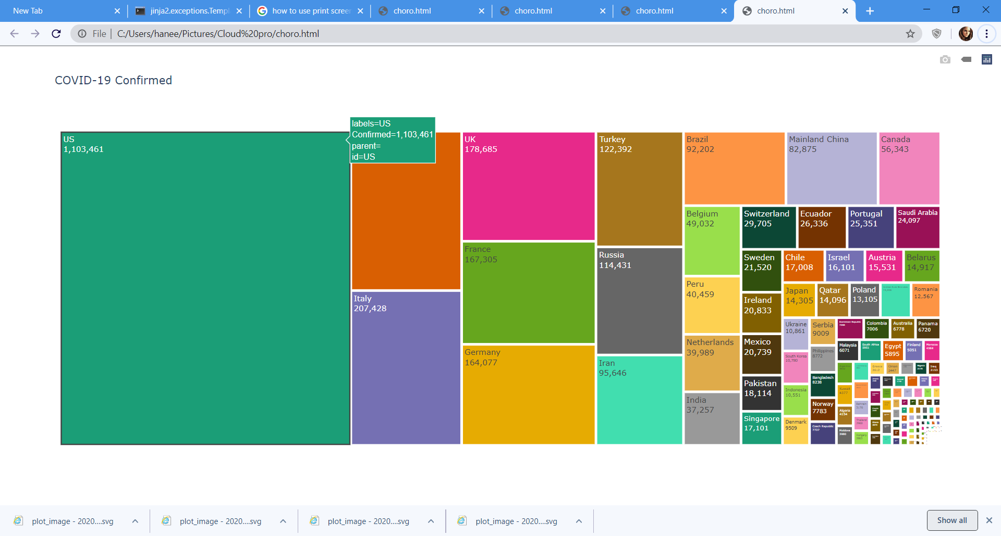
Treemap representation for Confirmed cases Worldwide

Slide 27
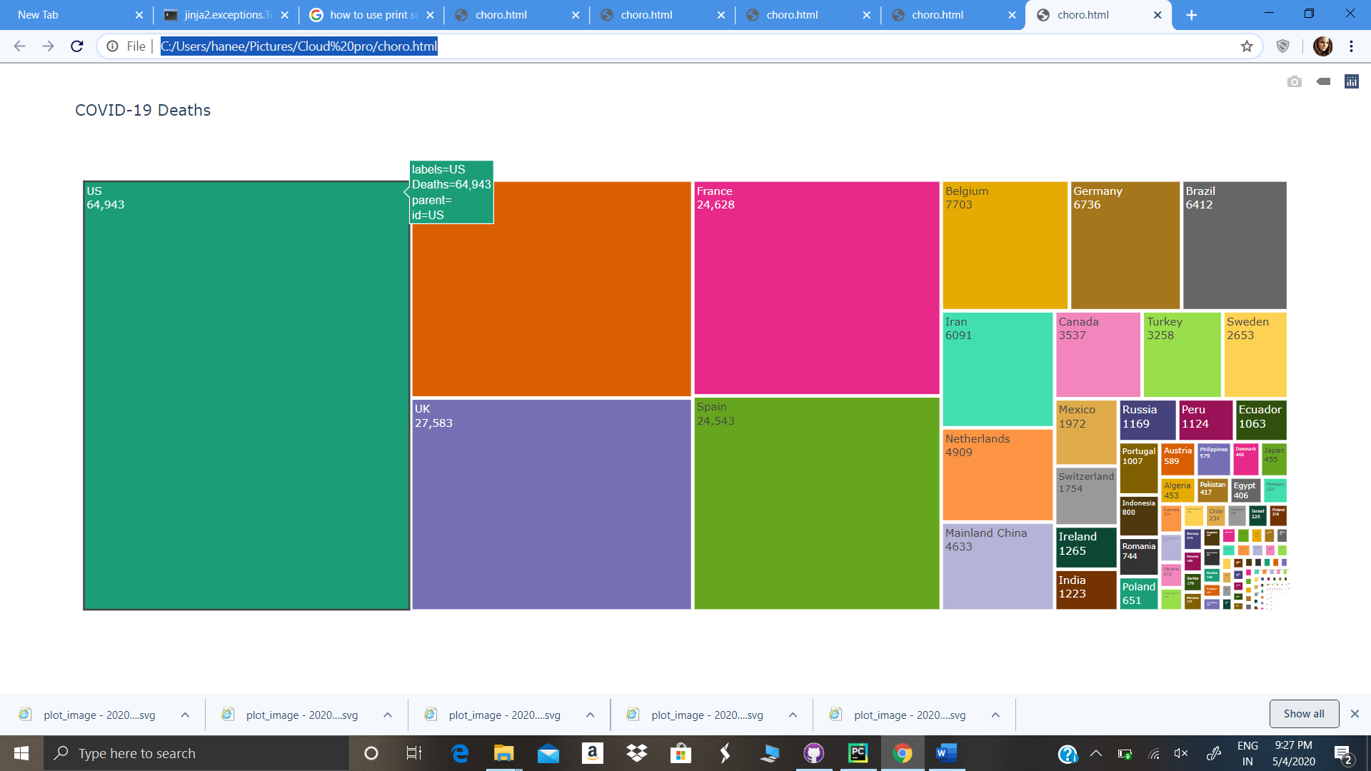
Treemap representation for Confirmed cases Worldwide

Slide 28

EBOLA Analysis

Slide 29
Ebola Analysis
Ebola virus disease formerly known as Ebola hemorrhagic fever is a severe often fatal illness in humans.
The virus is transmitted to people from wild animals and spreads in the human population through human-to-human transmission.
The dataset is downloaded from Kaggle and it contains columns:[‘Country’ , ’Date’ , ’Number of suspected cases ’ , ’Number of probable cases’, ’Number of confirmed cases’,’ Number of suspected deaths ’,’ Number of probable deaths ’,’ Number of confirmed deaths ’].
The data is read and grouped on the basis of Date and country.

Slide 30
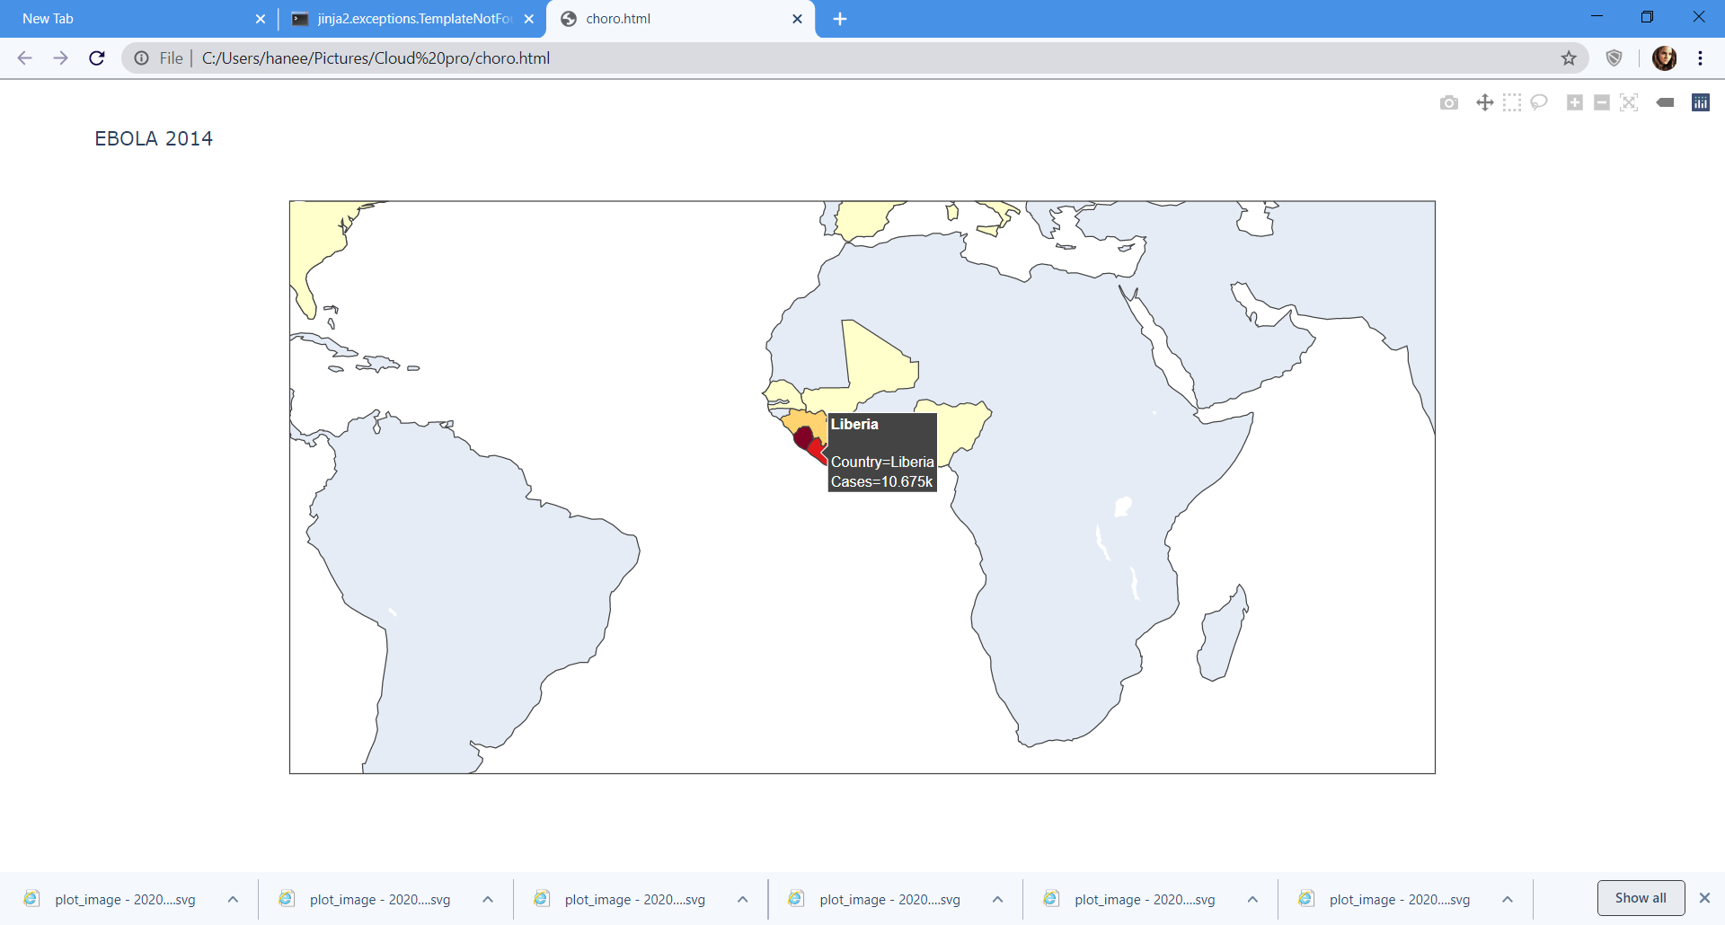
Choropleth representation for Confirmed cases Worldwide

Slide 31
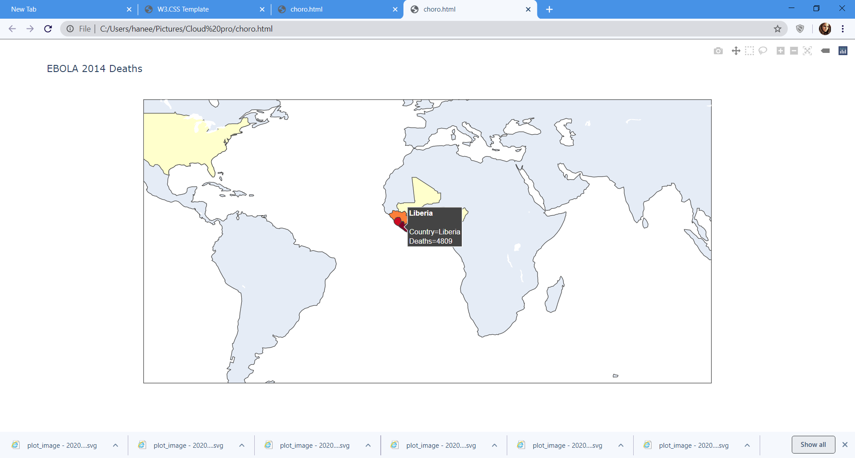
Choropleth representation for Death cases Worldwide

Slide 32
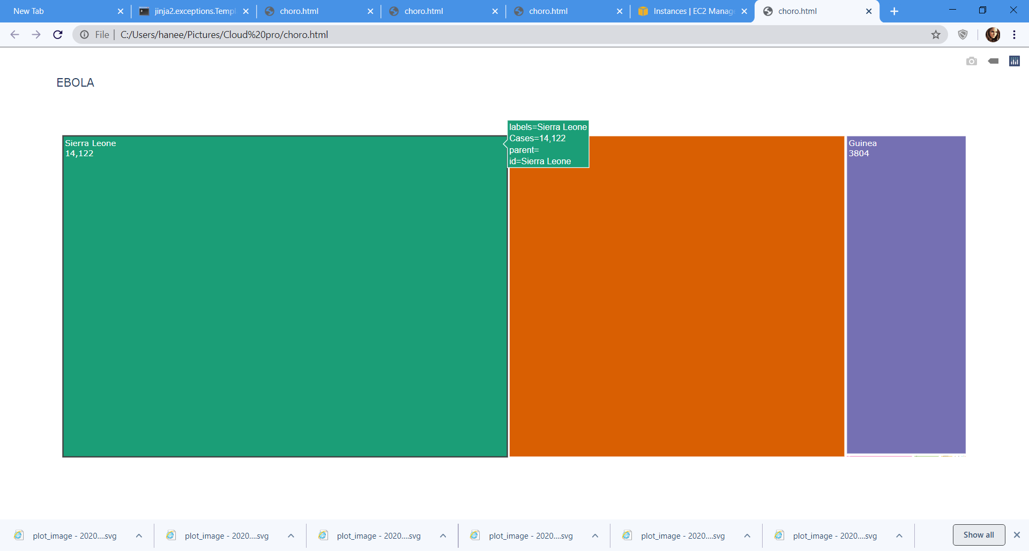
Treemap representation for Confirmed cases Worldwide

Slide 33
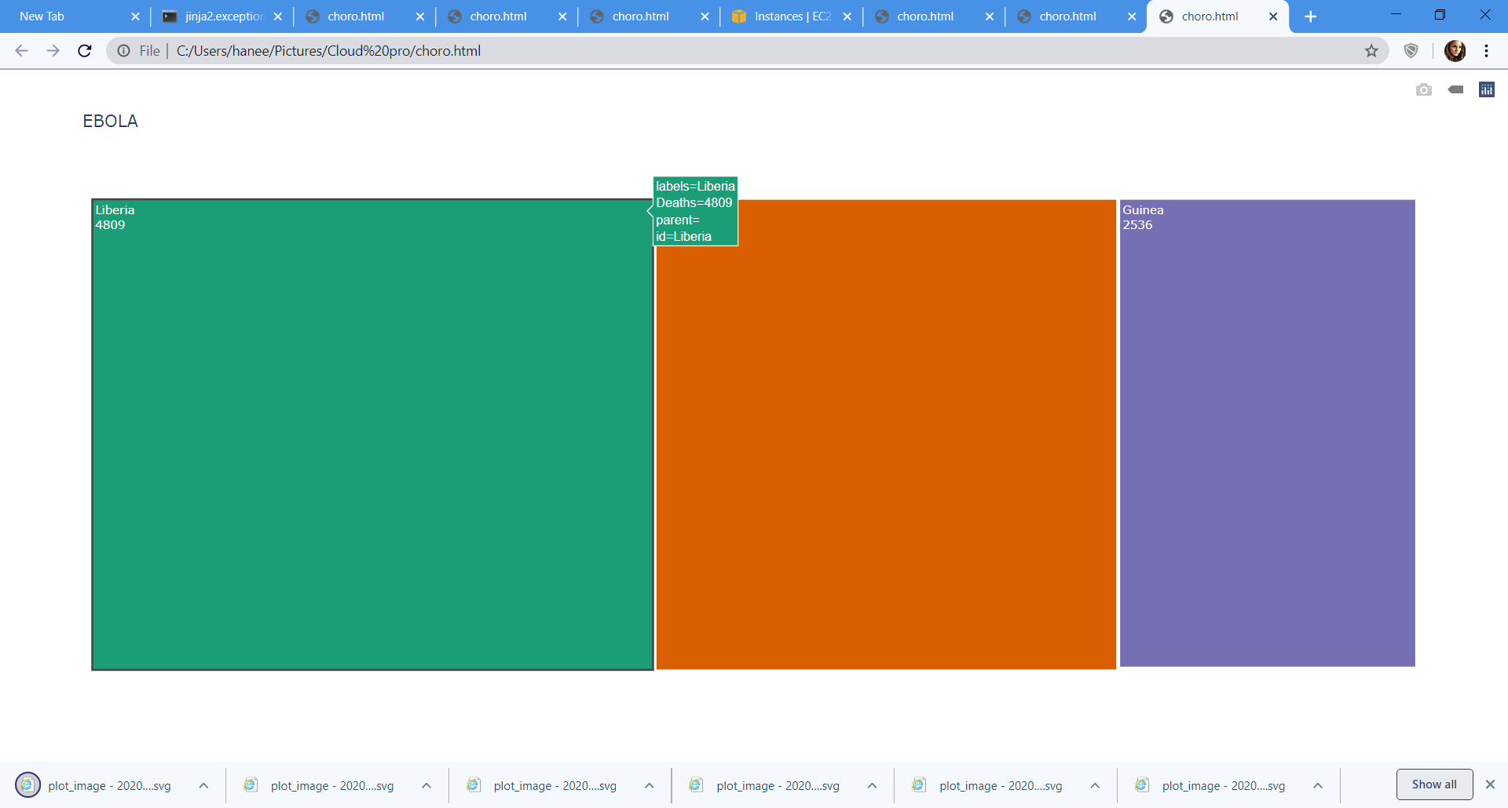
Treemap representation for Confirmed cases Worldwide

Slide 34

SARS Analysis

Slide 35
SARS Analysis
SARS is caused by a coronavirus, called SARS-coronavirus (SARS-CoV) similar on electron microscopy to animal coronaviruses. Coronaviruses are large, enveloped ribonucleic acid (RNA) viruses named after their corona- or crown-like surface projections observed on electron microscopy.
The dataset contains columns:[‘Country’ , ’Date’ , ’Number of cases ’ ,’ Number of deaths ’,’ Number of recovered’].
The data is read and grouped on the basis of Date and country.

Slide 36
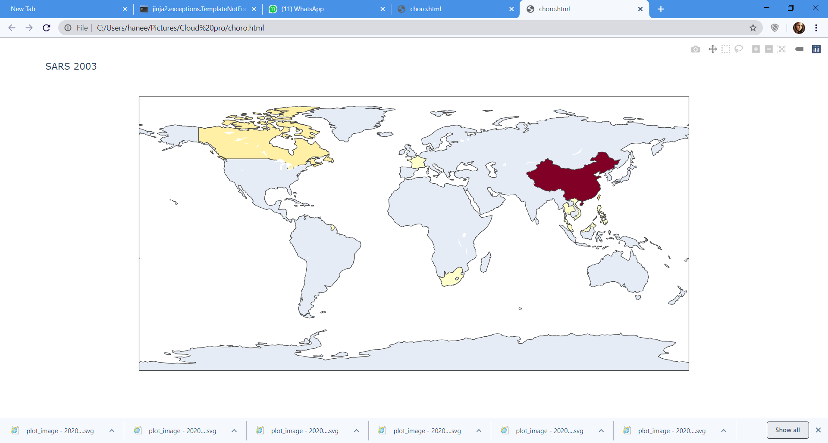
Choropleth representation for Confirmed cases Worldwide

Slide 37
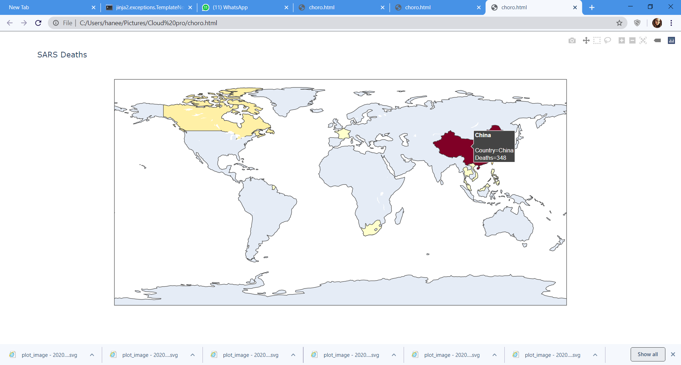
Choropleth representation for Death cases Worldwide

Slide 38
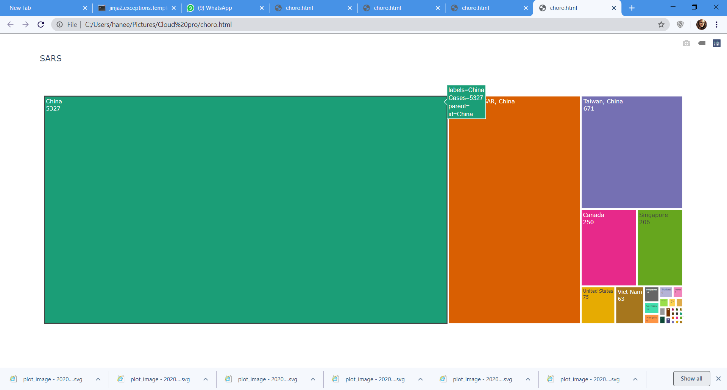
Treemap representation for Confirmed cases Worldwide

Slide 39
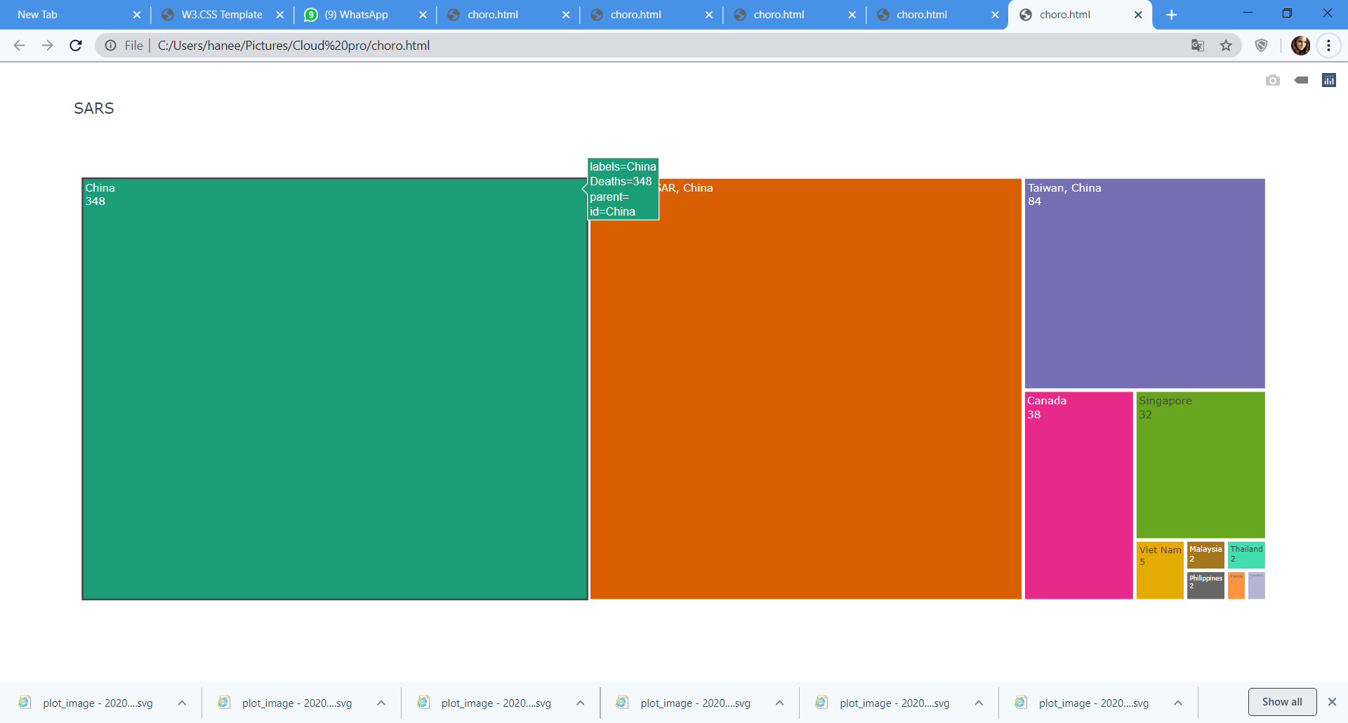
Treemap representation for Confirmed cases Worldwide

Slide 40

H1N1 Analysis

Slide 41
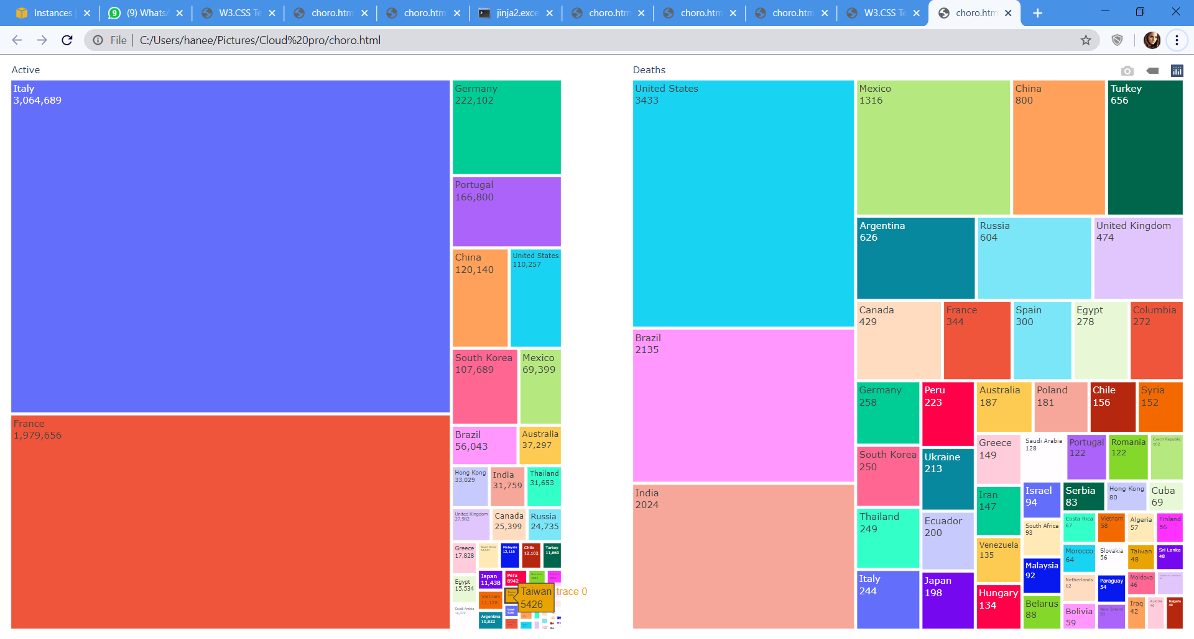
Treemap representation for Confirmed cases and Death cases

Slide 42
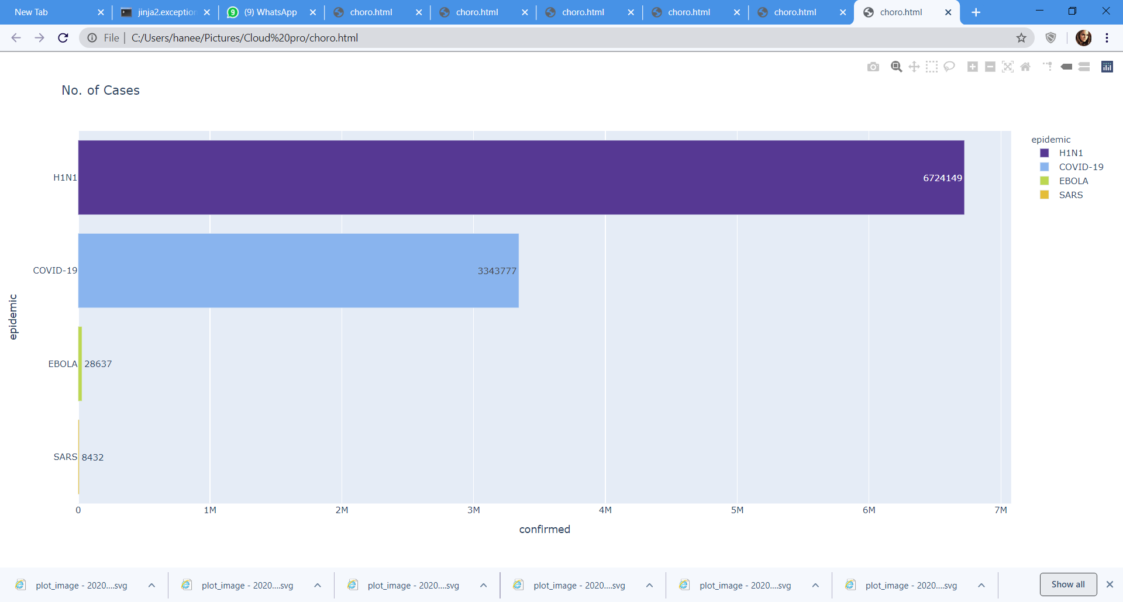
Comparison of different epidemics
No of cases

Slide 43
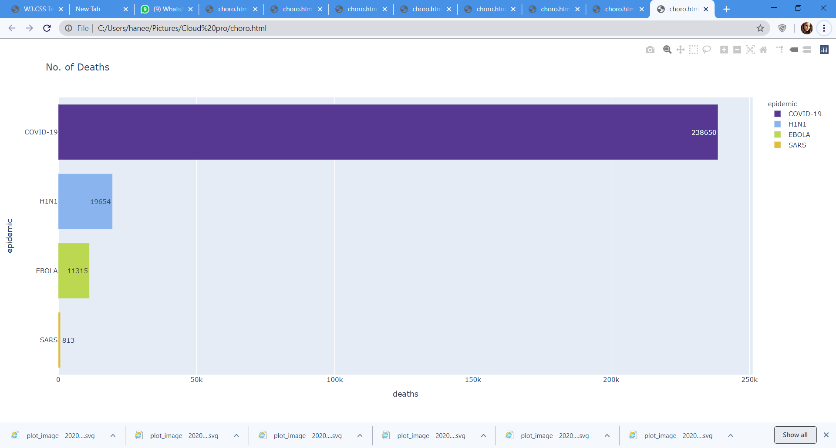
No of Deaths

Slide 44
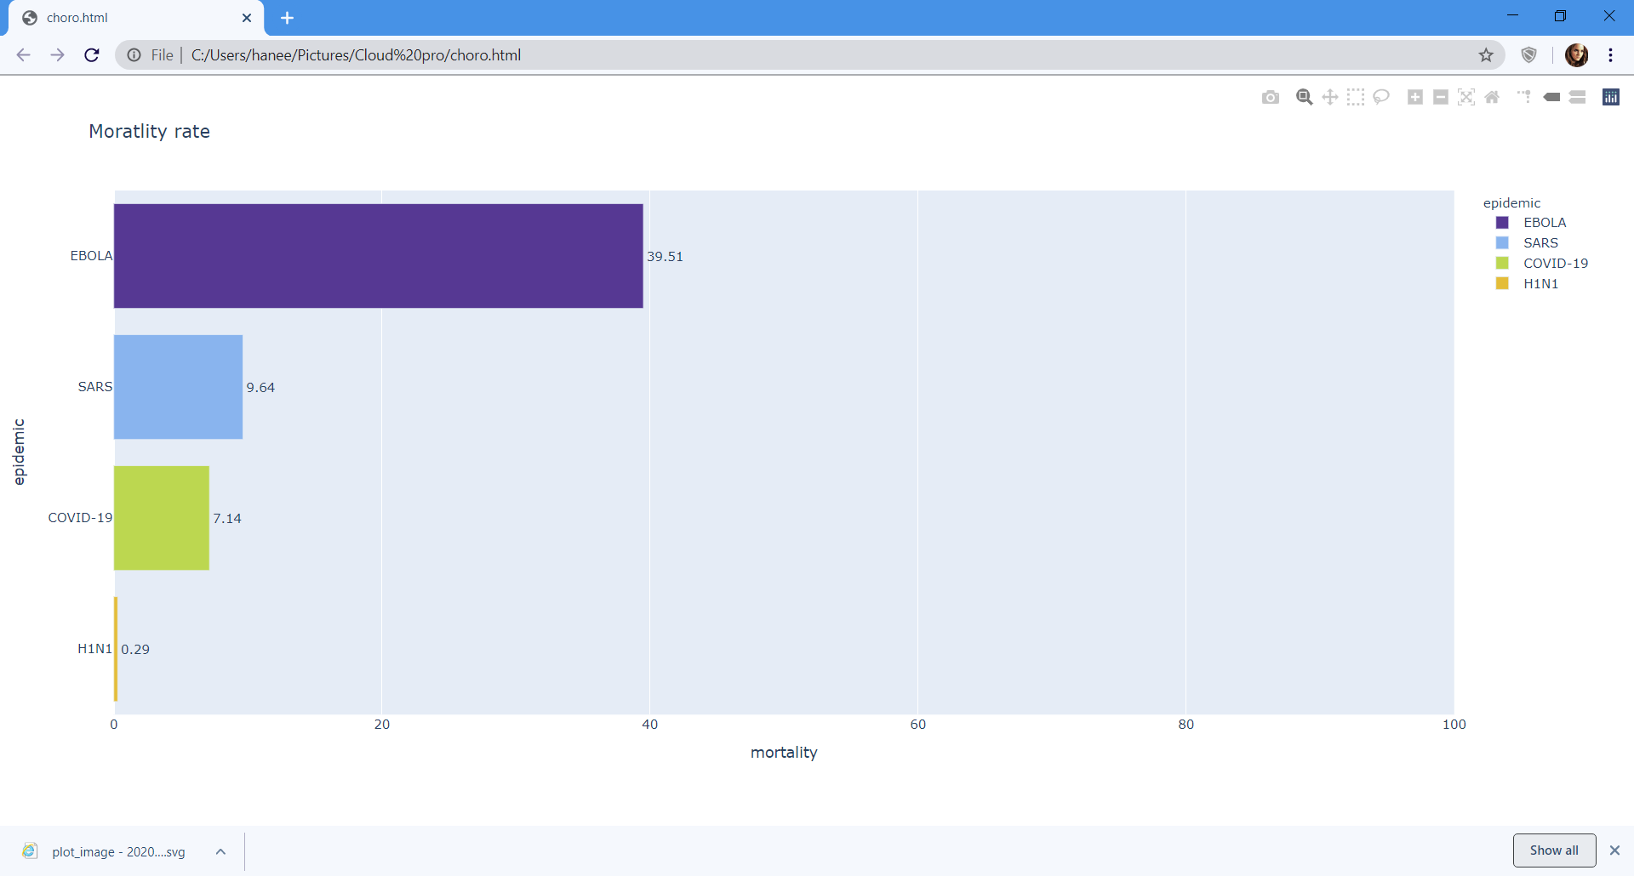
Mortality Rate

Slide 45
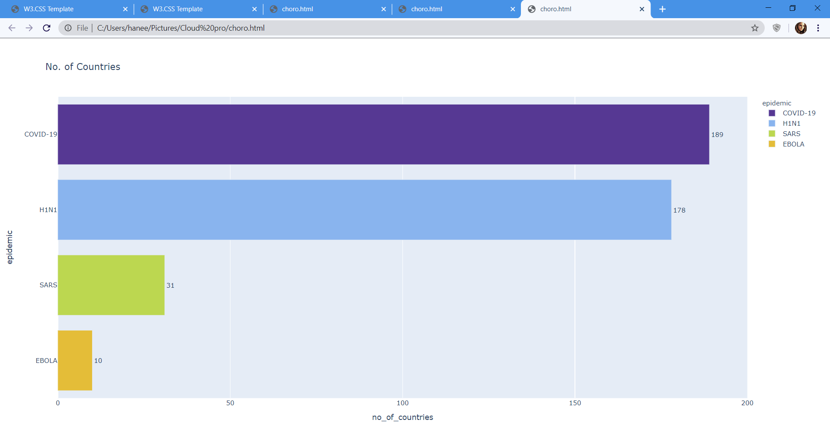
Number of Countries Affected

Slide 46
Problem Tackled/ Data Analyzed
Initially, as COVID-19 is an ongoing situation, for the its analysis we need to keep changing the data set (from the official websites) as the data keeps on updating. Now that we have came-up with this by automating the code, and it is now automatically updating the data for every 12 hours.
The datasets we have chosen to do the analysis contains null value’s so we have to perform exploratory data analysis(EDA) on all the datasets.
We did not found any available datasets for H1N1.

Slide 47
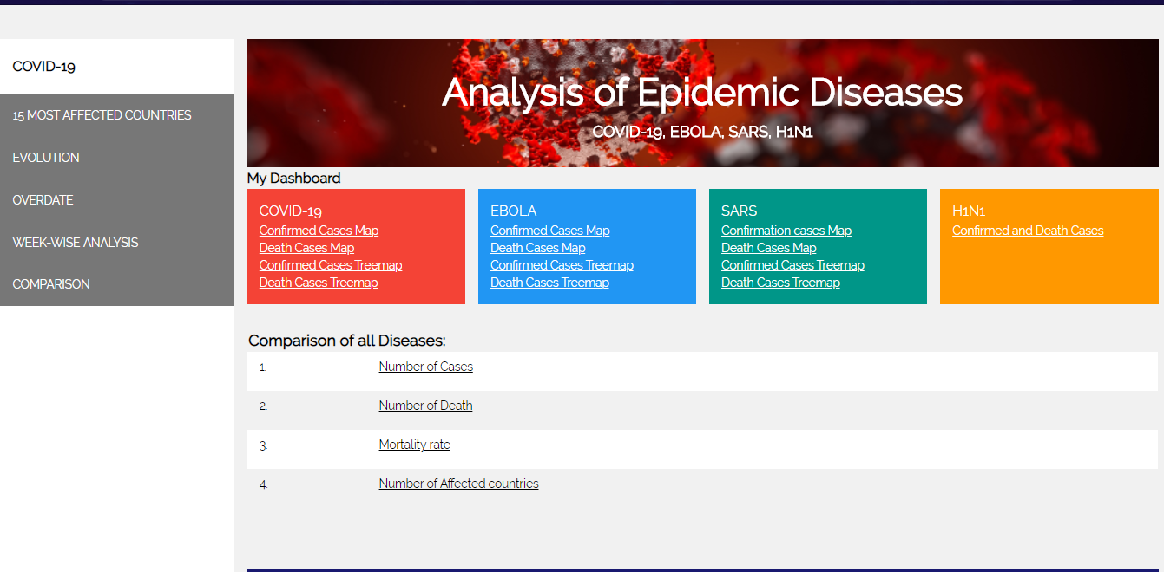
Webpage

Slide 48
Cloud Deployment
We have deployed the Webpage created using Flask in Amazon web services(AWS)
The webpage can be accessed by using the below http://52.15.100.164/

Slide 49
Trello Board and Github:
Trello Board link:
https://trello.com/b/GGRdqDg3/epidemic-diseases
Github Board link:
https://github.com/vishnuvardhanmanne/Cloud_Computing

Slide 50
References:
www.Kaggle.com
www.Wikipedia.com/H1N1

Slide 51
THANK YOU

